Slide 1

LENDING CLUB CASE STUDY
Group Members:
Sachin Gupta
Saibek Varghese Panicker

Slide 2
Problem Statement
A consumer finance company which specializes in lending various types of loans to urban customers. When the company receives a loan application, the company must decide for loan approval based on the applicant’s profile. Two types of risks are associated with the bank’s decision:
If the applicant is likely to repay the loan, then not approving the loan results in a loss of business to the company
If the applicant is not likely to repay the loan, i.e., he/she is likely to default, then approving the loan may lead to a financial loss for the company
Using Exploratory to understand how consumer attributes and loan attributes influence the tendency of default.

Slide 3
Problem Solving Approach:
Data understanding
Data cleaning :
Removal of unnecessary columns
Handle missing data
Reframing features acc to its datatypes.
Filter unwanted outliers.
Data manipulation:
Creation of derived cols
Conversion of numerical cols to buckets for analysis
Univariate analysis
Bivariate analysis
Conclusion

Slide 4
UNIVARIATE ANALYSIS
NUMERICAL UNIVARIATE ANALYSIS
CATEGORICAL UNIVARIATE ANALYSIS

Slide 5
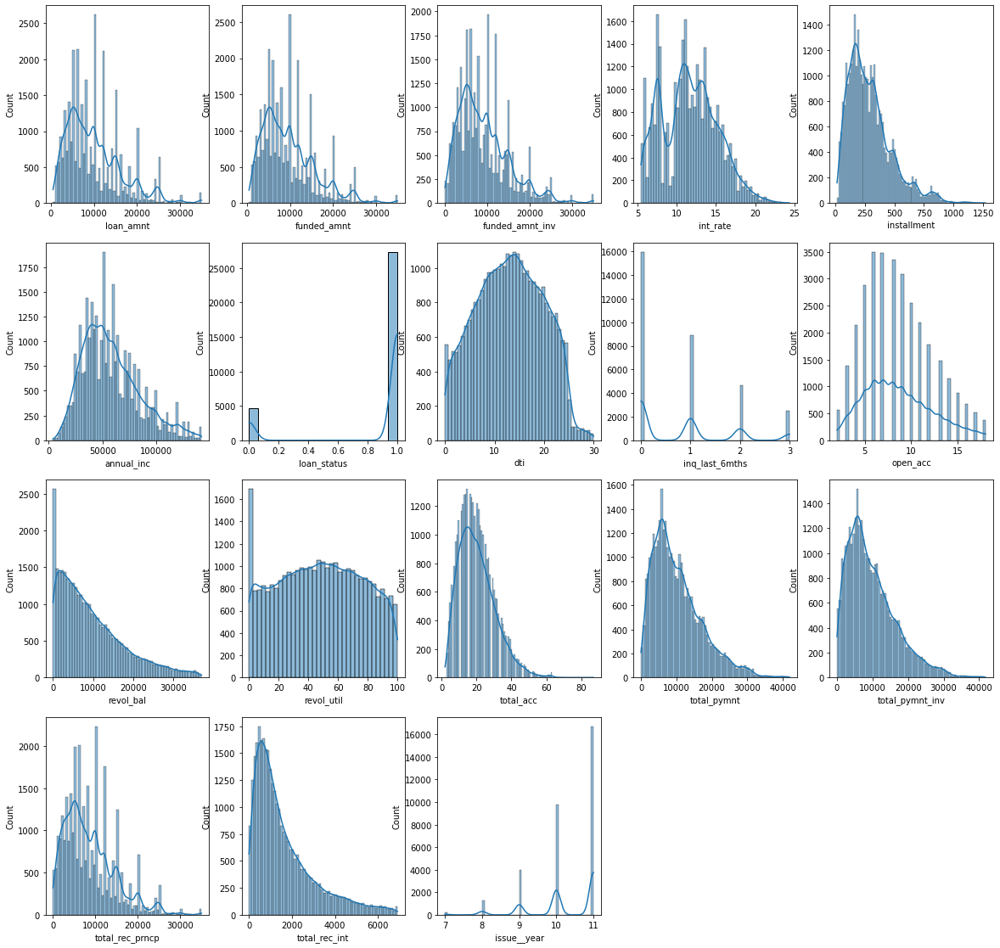
UNIVARIATE ANALYSIS ON NUMERICAL FEATURES

Slide 6

Numerical Univariate Observation
1. loan_amnt : Most of the loan_amnt has been taken upto 10,000
2. From the observed plot we can say that funded_amnt, funded_amnt_inv is same as loan_amnt
3. int_rate : Most of the interest rate for the loan given lies between 10-15%
4. installment : Most of the installment lies in the range of 250 (Somewhat around Median)
5. annual_inc : looks like a normal distribution curve (Majority of the income lies between 35k - 60k)
6. dti : It's a purely Normal Distribution Graph (Maximum Data lies in it's median/mean)
7. inq_last_6_months : Most people not inquired in the last 6 months (approx. : 50%)
8. open_acc : Most of the people open credit lines lies between 5-10
9. total_acc : Most of the people having total credit lines lies between 15-25
10. issue_year : As the years goes on the no. of people taking loans exponentially increases.
11. loan_status: 15% loan defaulters are present

Slide 7
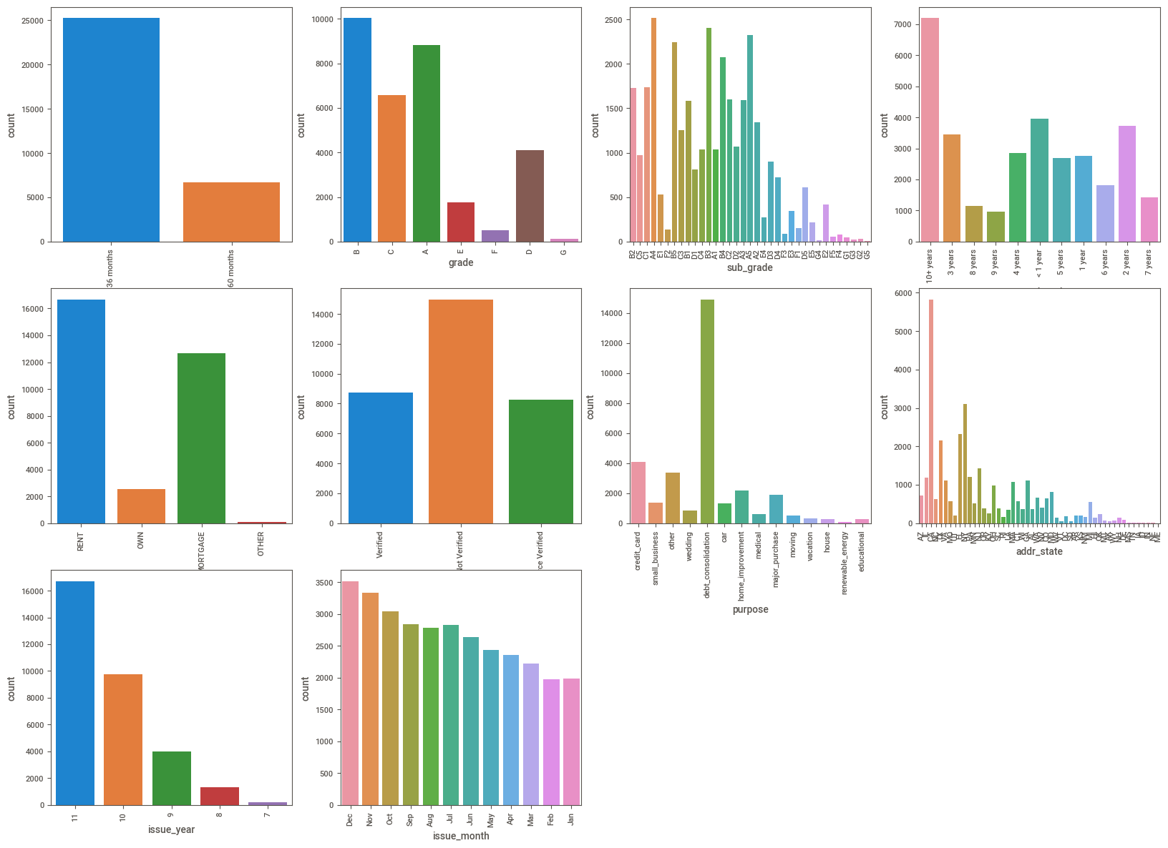
UNIVARIATE ANALYSIS ON CATEGORICAL FEATURES

Slide 8
Categorical Univariate Observation
1. term : 36 Months is the most frequent time period.
2. grade : A and B are the most frequently occurring loan grade.
3. emp_length : 10+ Years is the most frequent one.
4. home_ownership : Max people Took loan who belongs to RENT Category.
5. verification_status : Maximum people are not_verified status.
6. purpose : Majority of the reason of took the loan is debt_consolidation.
7.issue_month : Observed that at the end of the year most people takes loan bcoz they will give some offer etc. to the customer etc.

Slide 9
BIVARIATE ANALYSIS

Slide 10
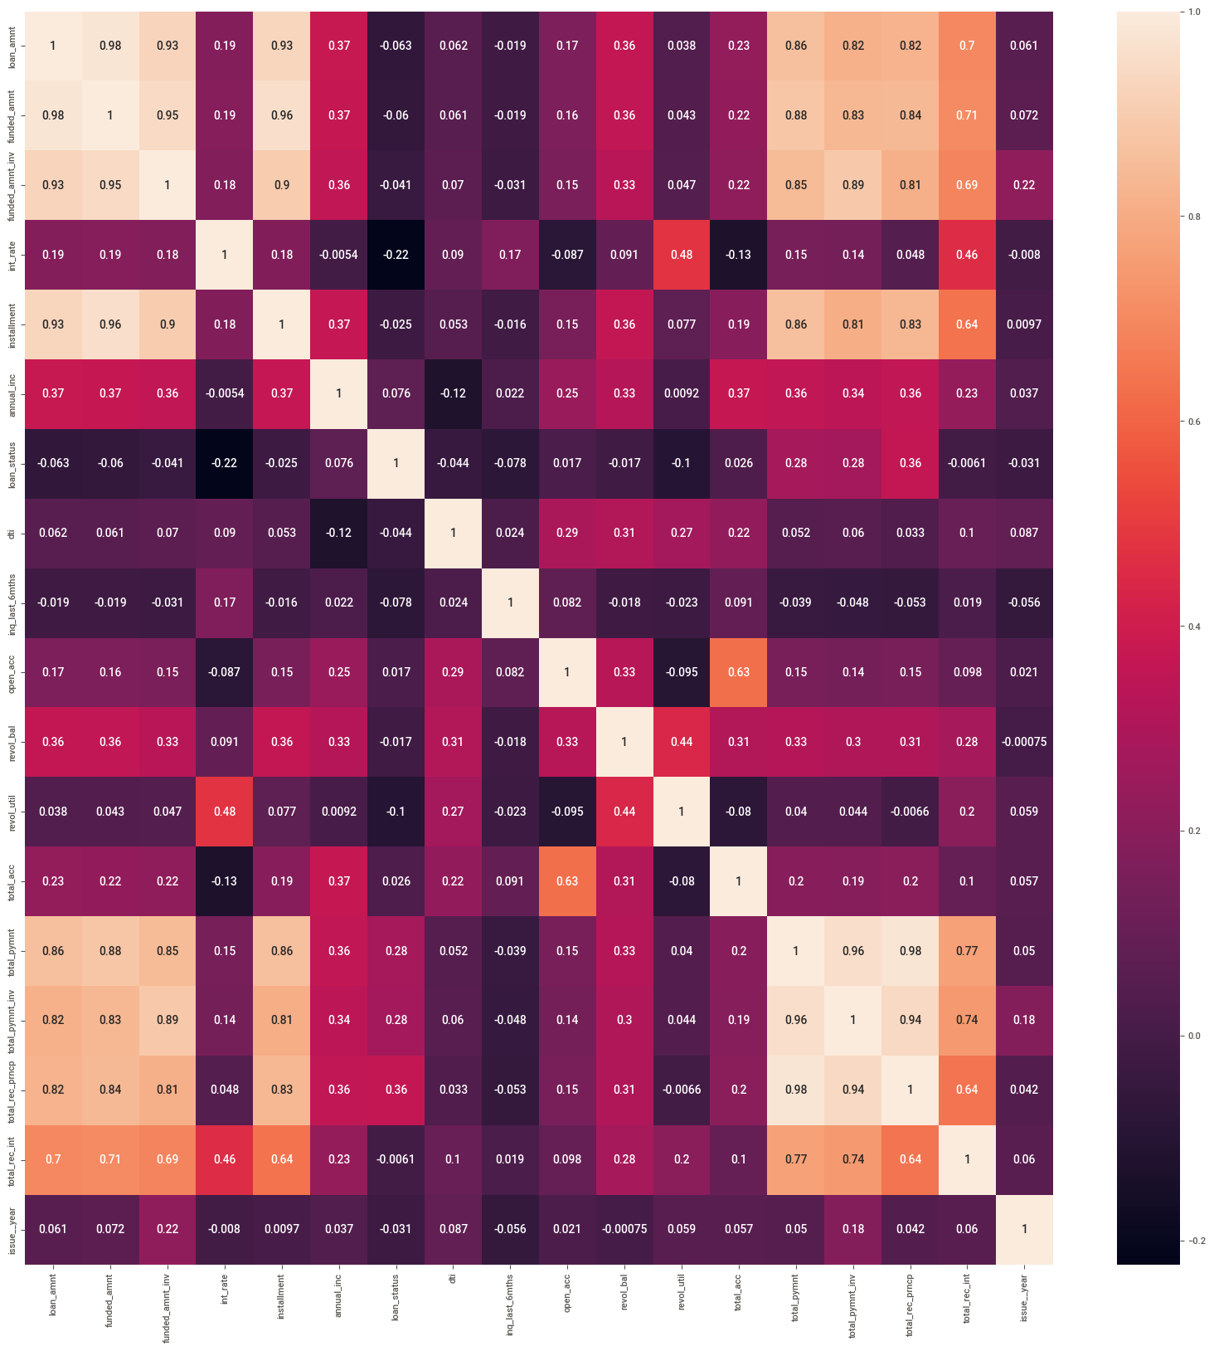
CORRELATION PLOT
Loan amount is highly correlated with funded_amnt, funded_amnt_inv and installment
total_pymnt is highy correlated with total_pymnt_inv and total_rec_prncp

Slide 11
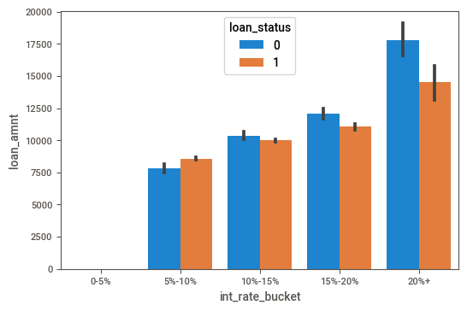
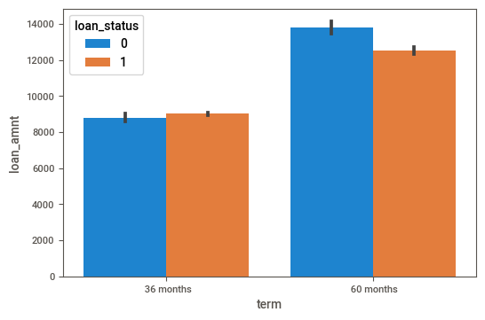
Loan Amount vs Interest rate bucket
Loan Amount vs Term
If interest rate and loan amount is higher then the defaulters are also higher.
For 60 months term the loan amount taken is higher, hence the defaulter is higher.

Slide 12
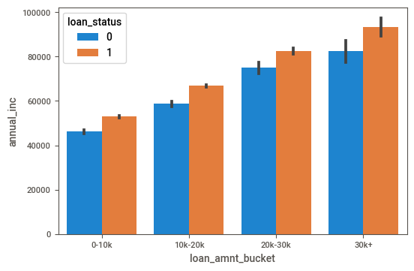
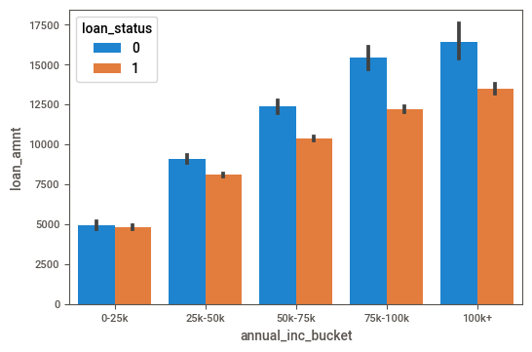
Annual Income vs Loan amount bucket
Loan Amount vs Annual income bucket
If the annual income is higher then people tend to take bigger loans where the defaulters considerably higher

Slide 13
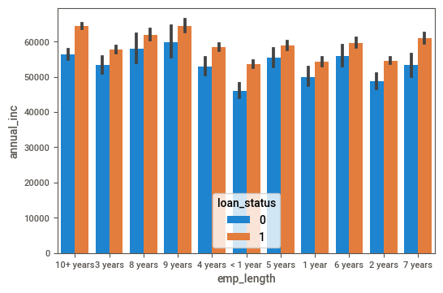
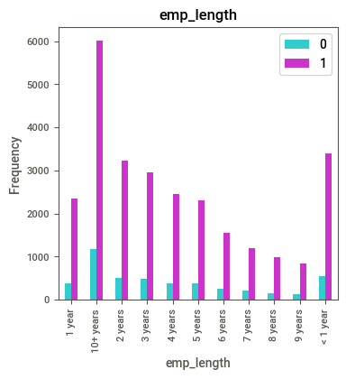
Annual Income vs Loan amount bucket
Emp length segmented analysis
People with less than 1 year of exp and who takes a loan have a greater chance to be in a defaulter range.

Slide 14
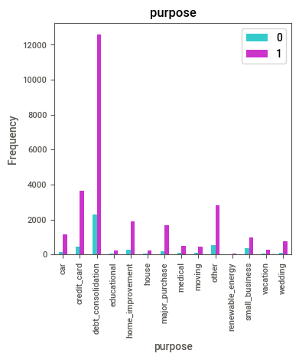
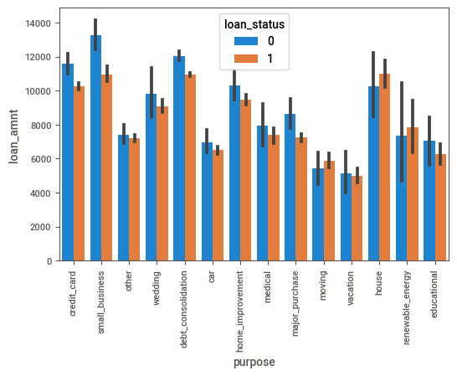
Loan Amount vs Purpose
Purpose segmented analysis
Max loan amount took for small_business which leads to more defaulters.
People who took loan for debt_consolodation are higher rate of defaulters and the maximum people took loan from debt_consolidation as well.

Slide 15
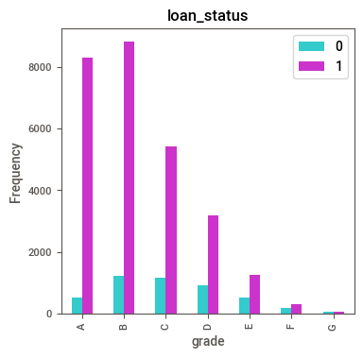
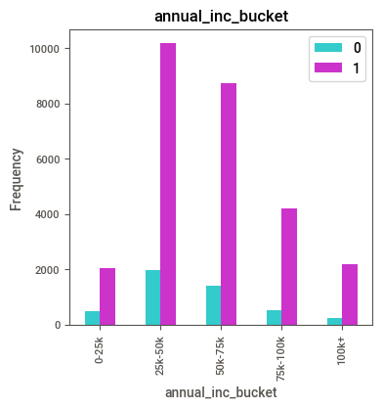
GRADE segmented
Annual income segmented
A and B grades have less defaulters as compared to others grade.
People having 25k-50k salary took more loan which leads to more defaulters.
ddf

Slide 16
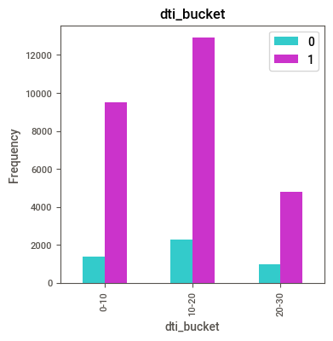
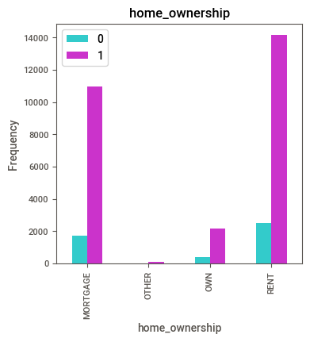
GRADE segmented
Annual income segmented
People who own a owned house tend to take lesser loan which leads to less defaulters.
People who comes under 10-20 dti_bucket tend to take more loans which leads to more defaulters.
ddf

Slide 17

From the univariate analysis the most imp. features which leads to loan defaulters are as follows:
Loan_amnt
int_rate
annual_inc
grade
emp_length
purpose
home_ownership

Slide 18

Final Observation
Loan amount is directly proportional to defaulters
Interest rate is directly proportional to defaulters
For 60 months term the loan amount taken is higher, hence the defaulter is higher.
As the year increases people tend to take more loans (exponentially increasing)
People with less than 1 year of exp and who takes a loan have a greater chance to be in a defaulter range.
People who own an owned house tend to take lesser loan which leads to less defaulters; people who have rented houses take more loans which tends to be defaulters
People having 25k-50k salary took more loan which leads to more defaulters.

